Slide 1




Second Phase Project Presentation
May 2023
Dayananda Sagar College of Engineering, Bangalore, Karnataka Department of Electronics & Communication Engineering
Design of FinFET based Combinational and Sequential circuits
USN :1DS19EC708 (Sec-D) Name: Bhanu Prasad Nayak
USN :1DS19EC710 (Sec-D) Name: Chinnappa Reddy gari Indu
USN :1DS19EC742 (Sec-D) Name: Thota Sai Gautham
USN :1DS20EC425 (Sec-D) Name: Pavan M
Project Batch No. :S-02
8th Semester
Project Guide
Dr. Dinesha .P

Slide 2
Overview of the project presentation
Introduction
Literature Survey
Problem Statement
Objectives
Tool used (Software)
Circuit Diagram
Results and discussions
Applications
Flow of the future works (Nov’22 – Jun’23)
References

Slide 3
Introduction
The power, area and delay plays a vital role in the design of the Integrated Circuits (IC).
Reduction of leakage power has become an issue in present scenario.
Leakage may be observed in microprocessors, microcontrollers, DSPs, etc. The processors need to have high performance and more speed.
The scaling of transistors leads to reduction in size of IC but the consequence of scaling down of transistors dimension end-up in the change of its channel behavior and results in short channel effect that increases the leakage power leads to increase in power consumption.

Slide 4
Introduction
Short channel effect is seen when the channel length is in the same order of magnitude as the depletion-layer widths of the source and drain.
To reduce these short channel effects and improve the leakage power, FinFET is the effective method.
FinFET is the abbreviation for “Fin shaped Field Effect Transistor”.
Due to structure of FinFET, it generate lower power leakage and enable great device density.
FinFET operate at low voltage and offer a high drive current all these mean much more performance can be packed into small area. Reducing cost per unit performance.

Slide 5
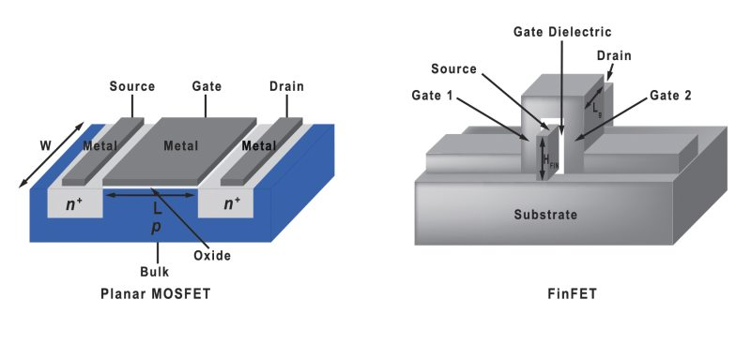
MOSFET AND FinFET
FinFET is a Fin shaped field effect transistor in which the channel is above the substrate and the gate of the transistor wraps around the channel. Fin is the channel between drain and source.
MOSFETs are planar devices with metal, oxide, and semiconductors involved in their basic structure.

Slide 6
MosFET v/s FinFET
MOSFETs and FinFETs are both types of transistors used in electronics. Here are some key differences between the two
Parameters | MosFET | FinFET
Channel Control | Channel is controlled by a single gate electrode. | FinFETs have multiple gate electrodes that surround the channel on three sides, providing better channel control and reducing the leakage current.
Channel Width | MOSFETs typically have a planar channel that is relatively wide. | FinFETs have a vertical fin-like channel that is much narrower.
Power Consumption | MOSFETs consumes more power than FinFETs. | FinFETs consume less power than MOSFETs, due to their better channel control and reduced leakage current.
Performance | MOSFETs have lower performance compare to FinFETs. | FinFETs have better performance than MOSFETs in terms of speed, power consumption, and leakage current.

Slide 7
Literature Survey
Sl.no | Paper/Journal name | Year | Observations
1 | Mr. Tilak Kumar L, Chandan A, Chethankumar K M, Dommeti Venkata Sai Krishna Vasanth, Hemant “Power Efficient 4 Bit Flash ADC Using Cadence Tool” International Research Journal of Engineering and Technology (IRJET) e-ISSN: 2395-0056 p-ISSN: 2395-0072 Volume: 09 Issue: 07 | 2022 | Of all ADC types, flash or parallel converters operate at the fastest speed. To boost performance while lowering power consumption, flash ADC design commonly plays a major part in other forms of ADCs
2 | An Efficient Priority Encoder& Decoder Using 45nm FinFET Technology. M Reddi Sekhar, P Uma, D Venkataramana, B Pushpalatha 3D Viswanada Reddy, 1Electronics & Communication Engineering, 1Aditya College of Engineering, Madanapalle, Chittoor Dist., A.P, India. | 2019 | Encoder and decoder are designed and compared between 45 nm CMOS and 32nm,65 nm FinFET Physical layout results implemented on SOC encounter tool is been observed
3 | Vedura Appala Raju, B.V. R. Gowri “Johnson Counter Using Master Slave D Flip Flop” International Journal of Management, Technology And Engineering Volume 8, Issue XII, DECEMBER/2018 ISSN NO : 2249-7455, Volume 8, Issue XII | 2018 | 4-bit Johnson counter is proposed which exhibits features like low power, high speed and cost efficient.

Slide 8
Literature Survey
Sl.no | Paper/Journal name | Year | Observations
4 | Vasudeva G, Shankar, Girish J R, “Design of High-Performance CMOS Comparator using 90nm Technology”. | 2016 | Proposed a high-performance CMOS comparator with low offset voltage with high gain.
5 | Shivali, Shobha Sharma, Amita Dev “Analysis of Various Master-Slave Configuration based D Flip-Flops” International Journal of Recent Technology and Engineering (IJRTE) ISSN: 2277-3878 (Online), Volume-8, Issue-1 | 2019 | Enumerates review on various earlier proposed master slave configuration based D flip flop models.

Slide 9
Problem Statement
Scaling of CMOS transistors leads to reduction in size of IC (Integrated Circuit), also results in short channel effects if the scaling is done beyond nanometer.
Short channel effect occurs when channel length approximately equal to charge region of source and drain. This causes rise in leakage current, mobility of carrier is reduced, threshold roll off and velocity saturation.

Slide 10
Objectives
To design and performance evaluation of combinational logic circuit 3bit-Flash ADC (comparator, priority encoder(8:3)).
To design and performance evaluation of sequential logic circuit 4bit-Johnson Ring Counter (D-flip flop ).
Performance evaluation includes : power dissipation, delay and area in both CMOS and FinFET.

Slide 11

TOOLS USED
The software tool is Cadence Virtuoso.
Cadence virtuoso is an Analog design environment which help designer fully analyze, and verify the design.
We used PTM (predictive technology model) files to study FinFET based results.

Slide 12
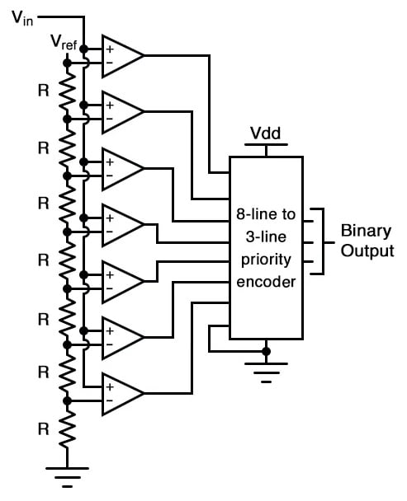
Circuit Diagram
3bit-Flash ADC

Slide 13
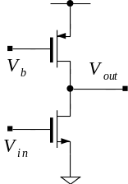
Common Source Amplifier
The CS amplifier is used to amplify the input analog signal and convert it into a voltage level that can be compared with the reference voltages.
The biasing network provides a stable DC voltage to the gate terminal to keep the amplifier in its linear amplification region.
When an AC input signal is applied, it modulates the current flowing through the FET channel, causing a voltage variation at the drain terminal.
The output of the CS amplifier is then connected to comparators that compare the voltage level with multiple reference voltages generated by a voltage divider network.
The output of the comparators represents the comparison result and determines the digital code representing the input voltage level.
common source amplifier

Slide 14
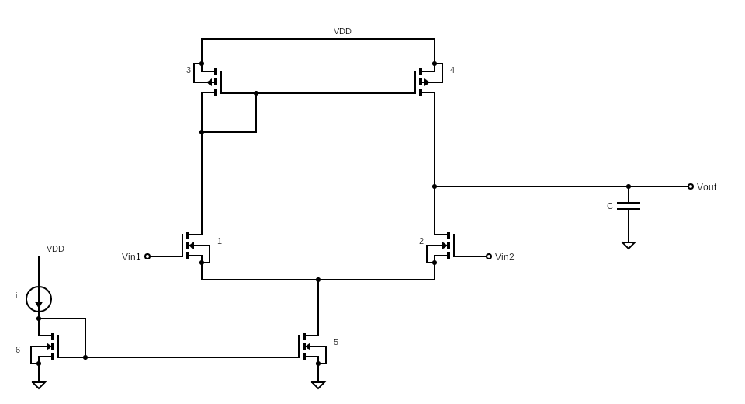
Differential Amplifier
The differential amplifier is used in the 3-bit flash ADC to perform the comparison of the amplified input signal with the reference voltages.
It operates based on the voltage difference between two input signals.
The differential amplifier has two inputs, commonly referred to as the non-inverting and inverting inputs.
The amplified output signal from the CS amplifier is connected to the non-inverting input of the differential amplifier.
The reference voltages generated by the voltage divider network are connected to the inverting inputs of the differential amplifier.
The differential amplifier amplifies the voltage difference between the non-inverting and inverting inputs and generates an output voltage that represents the result of the comparison.
The output of the differential amplifier is connected to a logic circuit that converts the analog output into a digital code, typically using a priority encoder or a similar circuit.
differential Amplifier

Slide 15
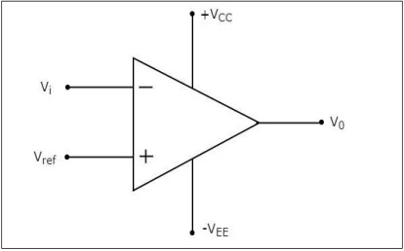
Comparator
We require (2^N) -1 comparators for designing a flash ADC
As we are designing a 3bit Flash ADC we require 7 Comparators
When ever the Vin is greater than Vref then the output is positive i.e. 1
If Vin is less than Vref then the output voltage is negative i.e. 0
These 1’s and 0’s are given as inputs to the encoder.
This comparator is implemented by designing the common source amplifier and differential amplifier.
Comparator

Slide 16
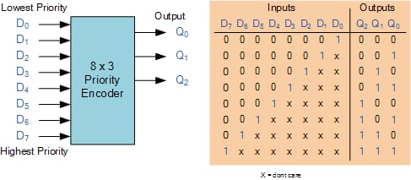
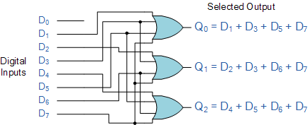
Priority Encoder (8:3)
Schematic of 8:3 encoder is done and is integrated with the comparator.
The output of comparator is given as the input of the encoder.
When ever the priority encoder gets input, the highest input which give +v (voltage) according to that the binary number is given.

Slide 17
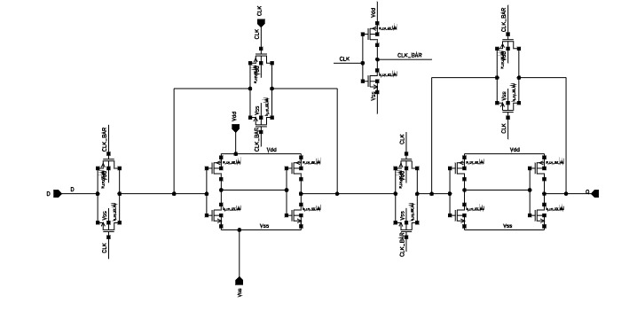
D Flip-flop
The Master-Slave D-flipflop is used to implement the Johnson Counter. An inverter cell is created with same transistor specifications and is directly used in the schematic.
2 additional NMOS transistors are used in the circuit for reset operation. A cell of the designed flip flop is created to use it as an instance in the Johnson counter designing.
D-flipflop

Slide 18
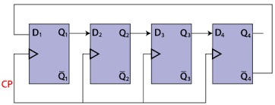
Johnson Counter
The Johnson counter is the cascaded arrangements of n flip-flop. The inverted output of last flipflop is given as the input to the first flipflop. Here it is a 4-bit Johnson Ring Counter made of four D flip-flop and same clock is given to all.
The Johnson counter is a type of counter created using shift registers and if we apply serial data signal to the input of the serial-in to serial-out shift registers, the same sequence of data will exit from the last flipflop in the register chain.
Johnson counter

Slide 19
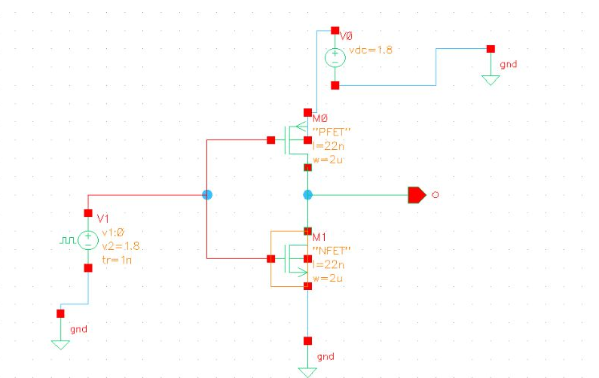
Results and discussions
Inverter schematic:
v pulse is 1.8 v
Period is 20n s
Pulse width is 20n s
Rise time 1 n s
Fall time 1n s

Slide 20
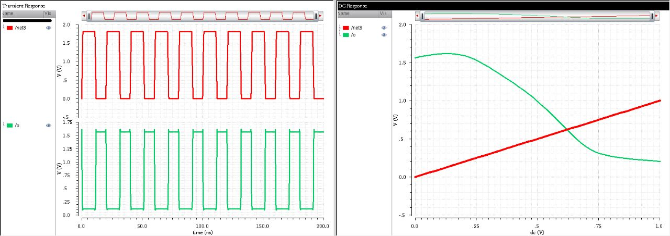
22nm CMOS Inverter

Slide 21
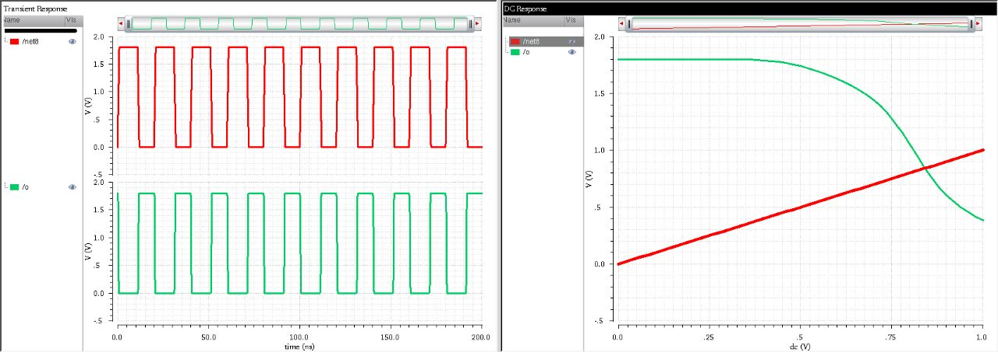
22nm FinFET Inverter

Slide 22
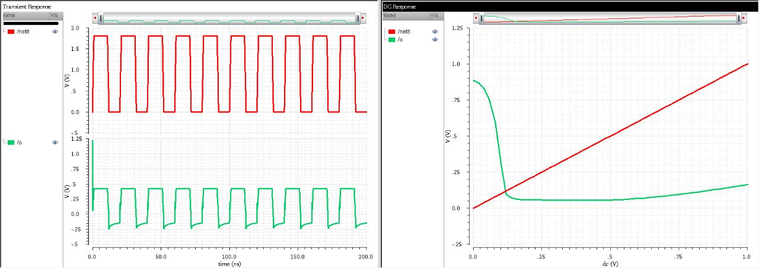
7nm CMOS Inverter

Slide 23
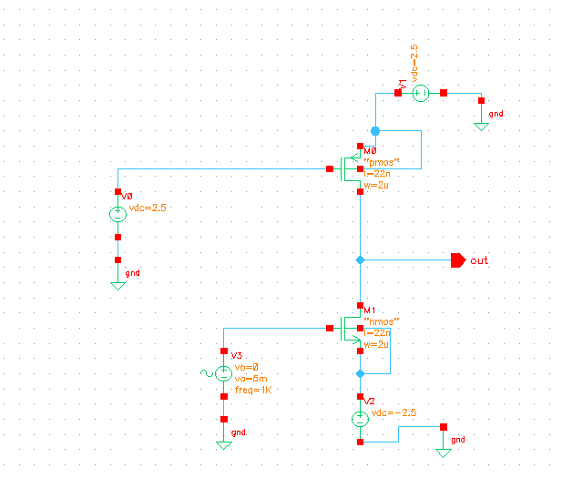
Common Source Amplifier
v sin :
amplitude : 5m
Frequency : 1K Hz

Slide 24
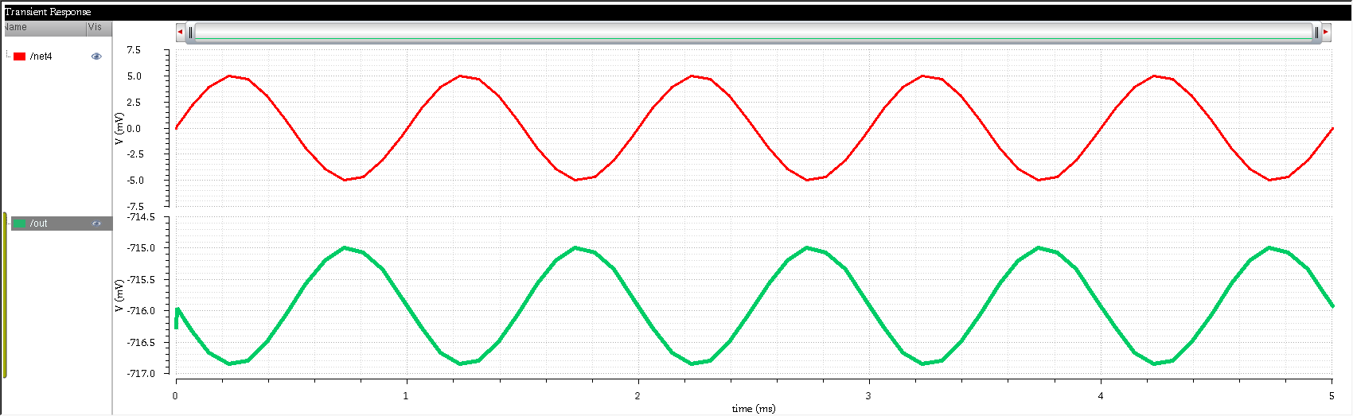
22nm CMOS Common Source Amplifier
Net 14 is input (red)
Out : Amplified output (green)

Slide 25
22nm FinFET Common Source Amplifier
Net 14 is input (red)
Out : Amplified output (green)

Slide 26
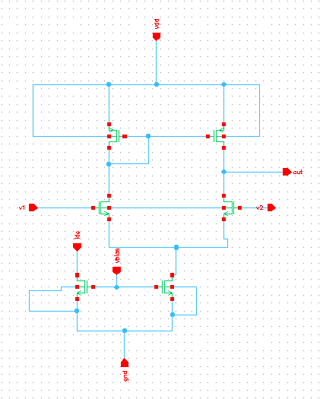
Differential Amplifier
V1 sin :
amplitude 5m
frequency 1 K Hz
V2 : gnd

Slide 27
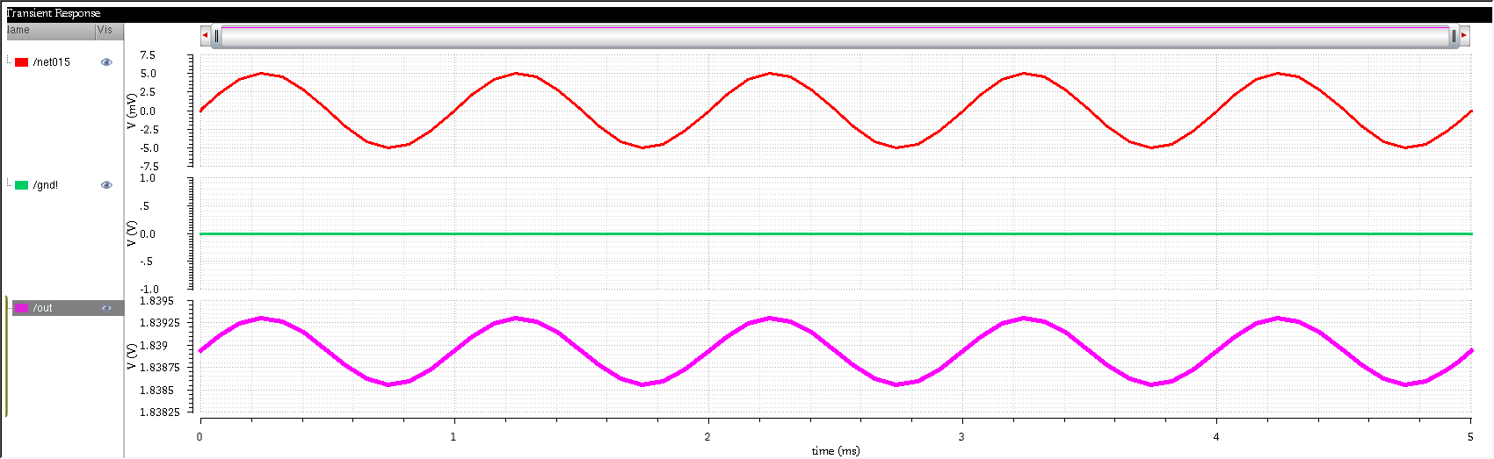
22nm CMOS Differential Amplifier
Net 15 : sin wave (red)
Gnd : ground ( green)
Out : amplified difference of voltages (pink)

Slide 28
22nm FinFET Differential Amplifier
Net 15 : sin wave (red)
Gnd : ground ( green)
Out : amplified difference of voltages (pink)

Slide 29
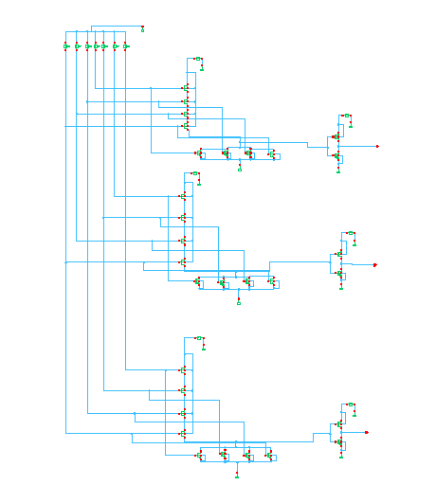
Priority Encoder (8:3) Schematic
Q0 = ∑(1,3,5,7)
Q1 = ∑(2,3,6,7)
Q2 = ∑(4,5,6,7)

Slide 30
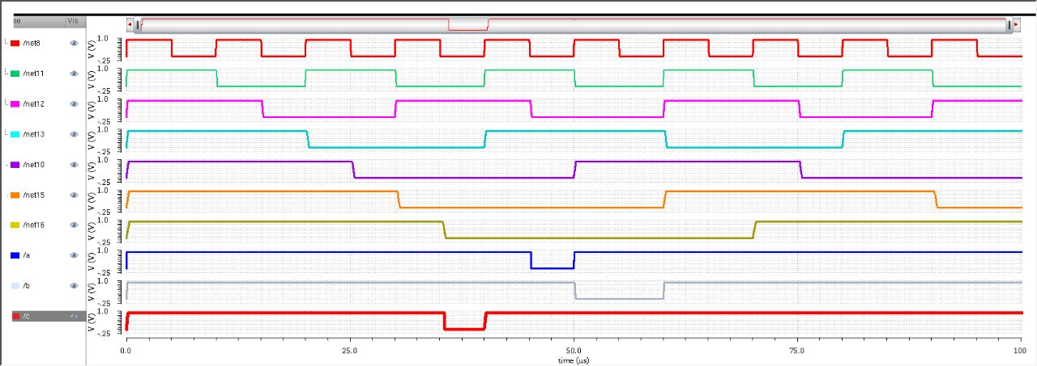
22nm CMOS 8:3 Priority Encoder Waveforms
Net 0- 7 : inputs d1 –d7 of time period 10u to 80 u respectively
A,B,C are outputs
A is MSB and C is LSB

Slide 31
22nm FinFET 8:3 Priority Encoder Waveforms
Net 0- 7 : inputs d1 –d7 of time period 10u to 80 u respectively
A,B,C are outputs
A is MSB and C is LSB

Slide 32
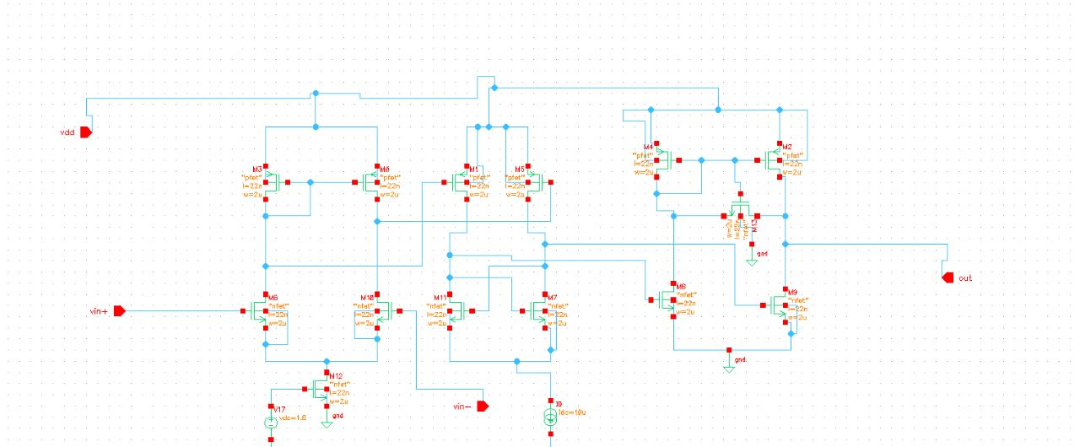
Comparator
It has 3 parts
Pre amplifier
Decision maker
Buffer

Slide 33
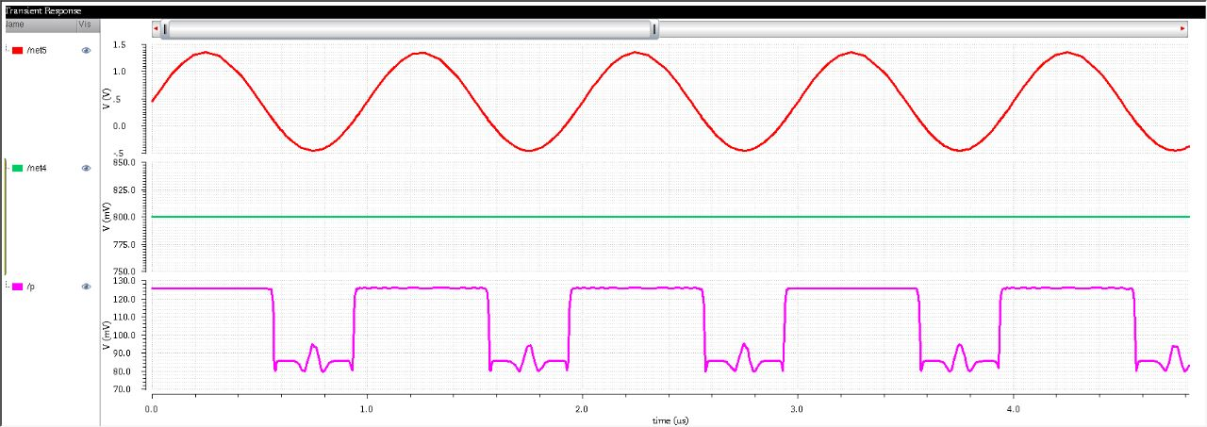
22nm CMOS Comparator
Net 15 : sin wave
Amplitude : 1 v
Frequency : 1M Hz (red)
Net 14 : vdc : 800m v (green)
P : comparator output (pink)

Slide 34
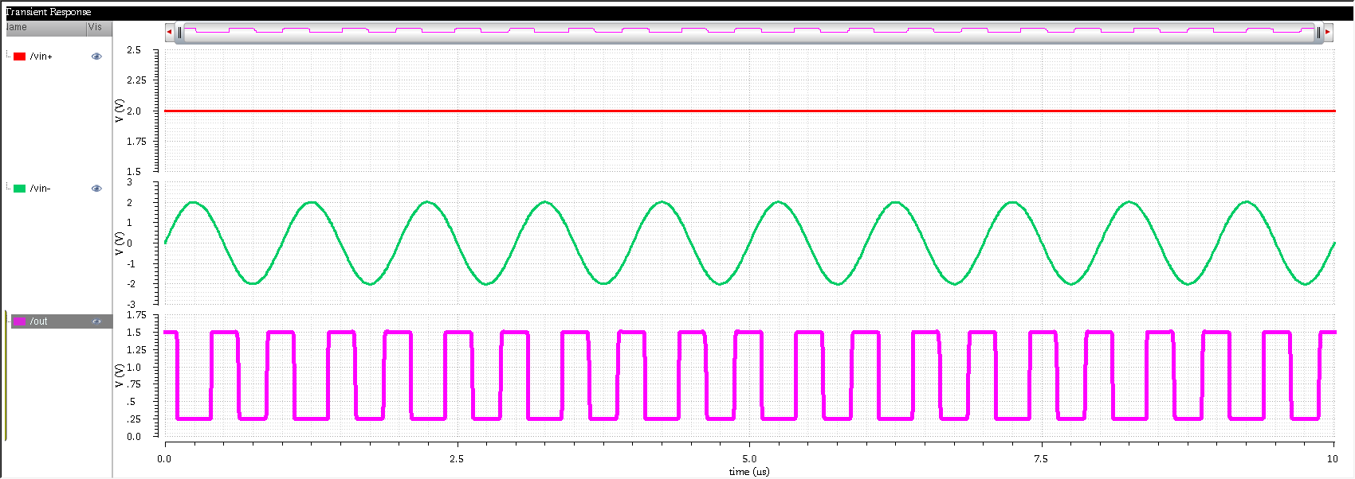
22nm FinFET Comparator
Vin - : sin wave
Amplitude : 1.5 v
Frequency : 1M Hz (green)
Vin +: vdc : 2 v (red)
P : comparator output (pink)

Slide 35
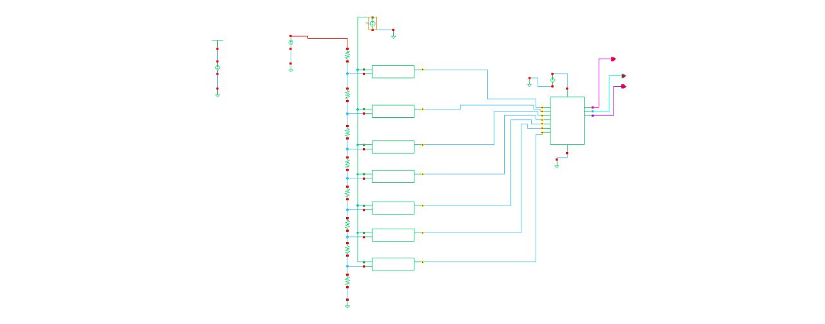
3-bit Flash ADC

Slide 36
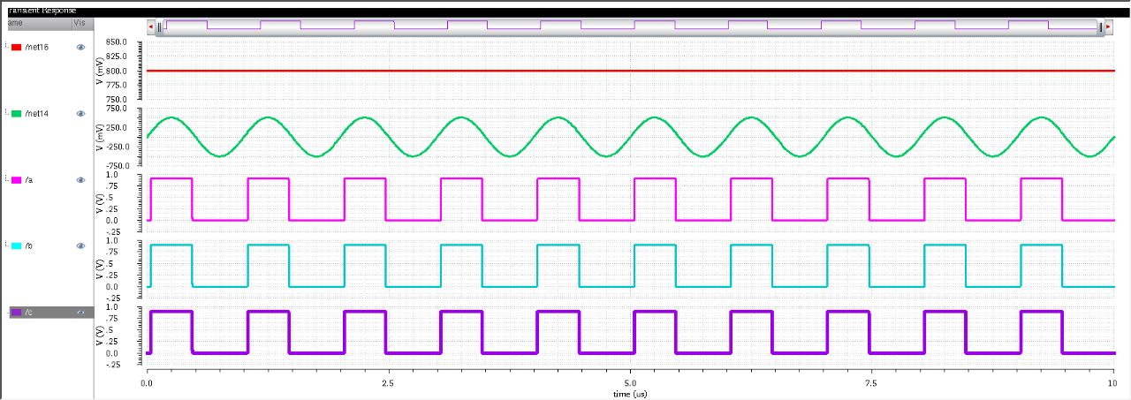
22nm CMOS 3-Bit Flash ADC

Slide 37
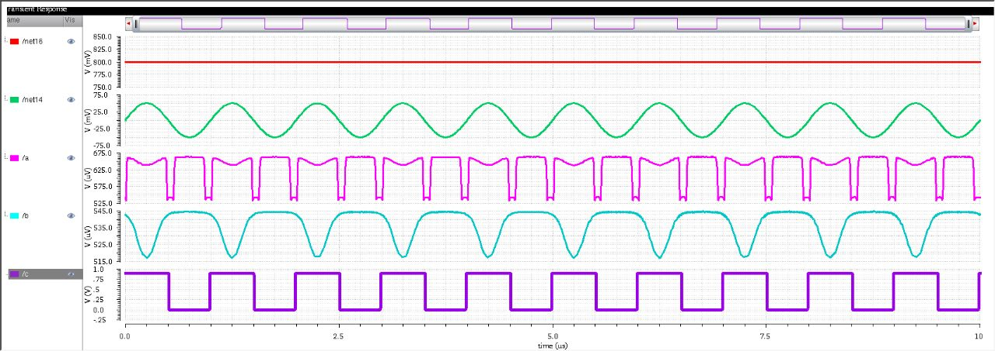
22nm CMOS 3-Bit Flash ADC

Slide 38
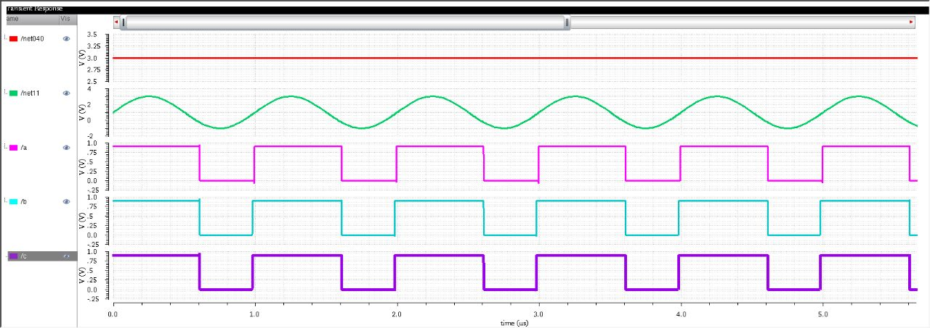
22nm FinFET 3-Bit Flash ADC

Slide 39
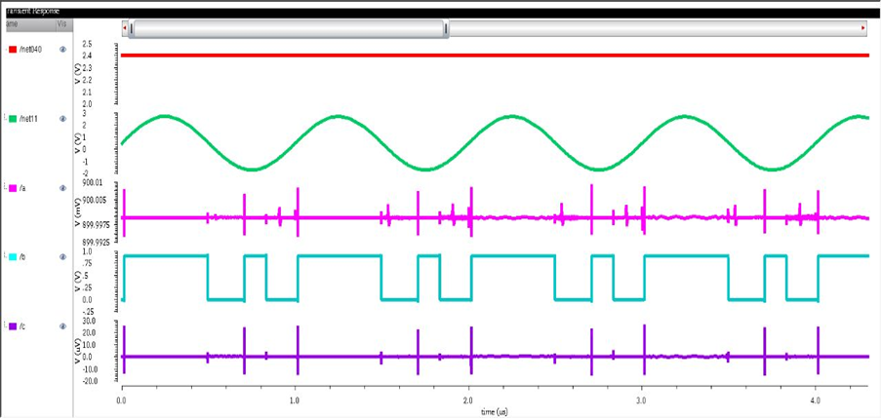
22nm FinFET 3-Bit Flash ADC
Vin | code | a b c
0<vin≤0.3 | 0000000 | 000
0.3<vin≤0.6 | 0000001 | 001
0.6<vin≤0.9 | 0000011 | 010
0.9<vin≤1.2 | 0000111 | 011
1.2<vin≤1.5 | 0001111 | 100
1.5<vin≤1.8 | 0011111 | 101
1.8<vin≤2.1 | 0111111 | 110
2.1<vin | 1111111 | 111

Slide 40
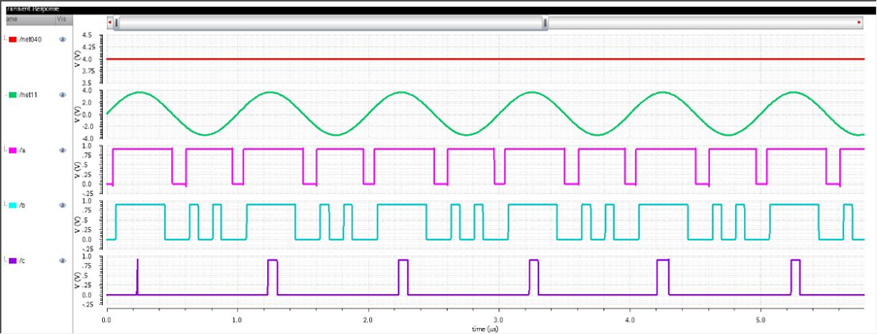
22nm FinFET 3-Bit Flash ADC
Vin | code | a b c
0<vin≤0.5 | 0000000 | 000
0.5<vin≤1 | 0000001 | 001
1<vin≤1.5 | 0000011 | 010
1.5<vin≤2 | 0000111 | 011
2<vin≤2.5 | 0001111 | 100
2.5<vin≤3 | 0011111 | 101
3<vin≤3.5 | 0111111 | 110
3.5<vin | 1111111 | 111

Slide 41
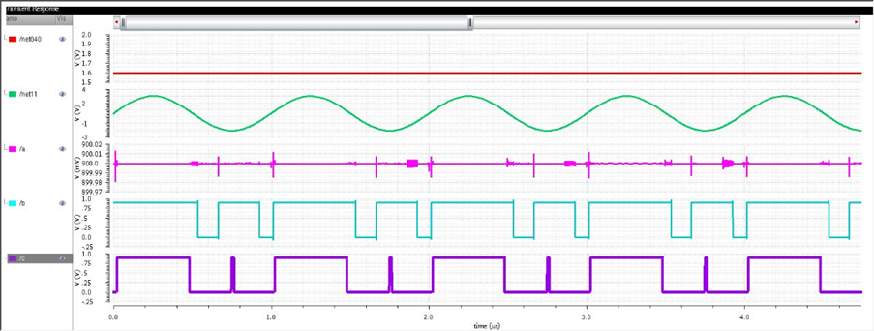
22nm FinFET 3-Bit Flash ADC
Vin | code | a b c
0<vin≤0.2 | 0000000 | 000
0.2<vin≤0.4 | 0000001 | 001
0.4<vin≤0.6 | 0000011 | 010
0.6<vin≤1.8 | 0000111 | 011
0.8<vin≤1 | 0001111 | 100
1.0<vin≤1.2 | 0011111 | 101
1.2<vin≤1.4 | 0111111 | 110
1.4<vin | 1111111 | 111

Slide 42
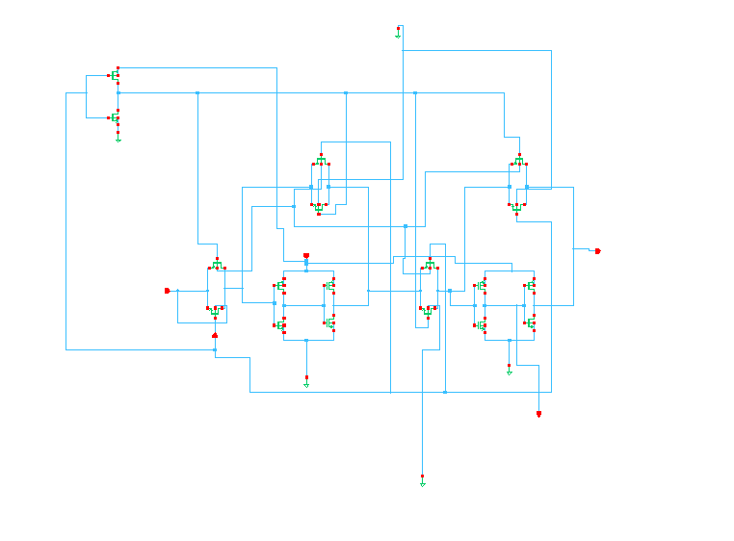
D Flip-Flop
Negative edge transmission gate master slave flip flop

Slide 43
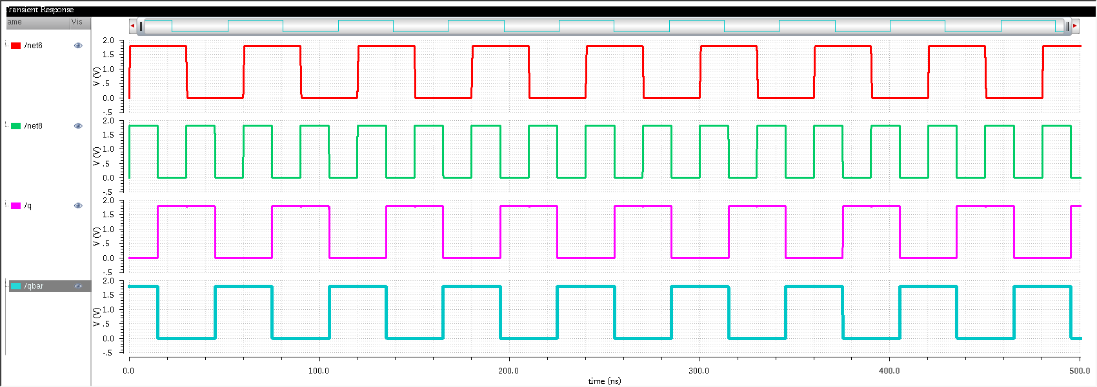
22nm CMOS D Flip-Flop
Net 06 : d
V pulse : 1.8 v
period 60n
Width 30n(red)
Net 8: v pulse : 1.8 v
Period : 30n
Width : 15n(green)
Q and qd are outputs (pink and blue )

Slide 44
22nm FinFET D Flip-Flop
Net 06 : d
V pulse : 1.8 v
period 60n
Width 30n(red)
Net 8: v pulse : 1.8 v
Period : 30n
Width : 15n(green)
Q and qd are outputs (pink and blue )

Slide 45
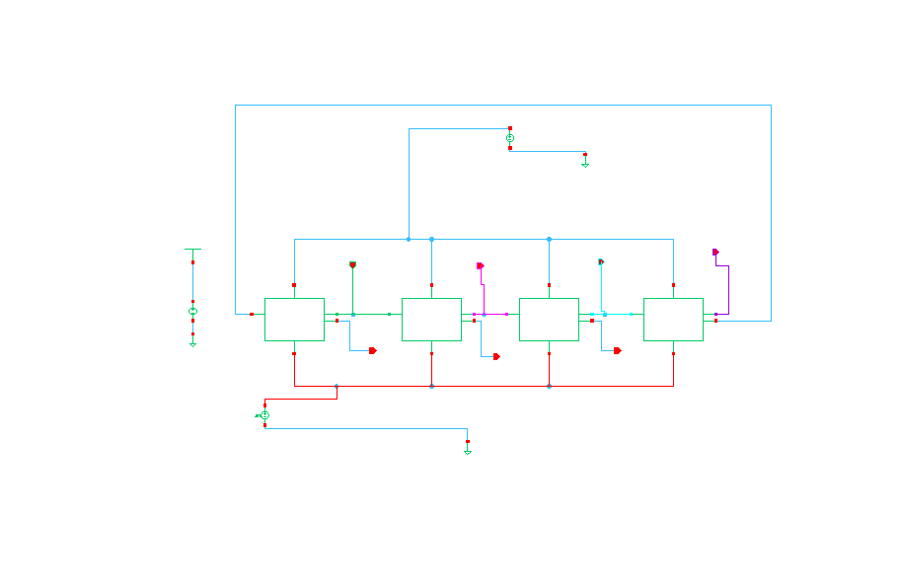
Johnson Counter

Slide 46
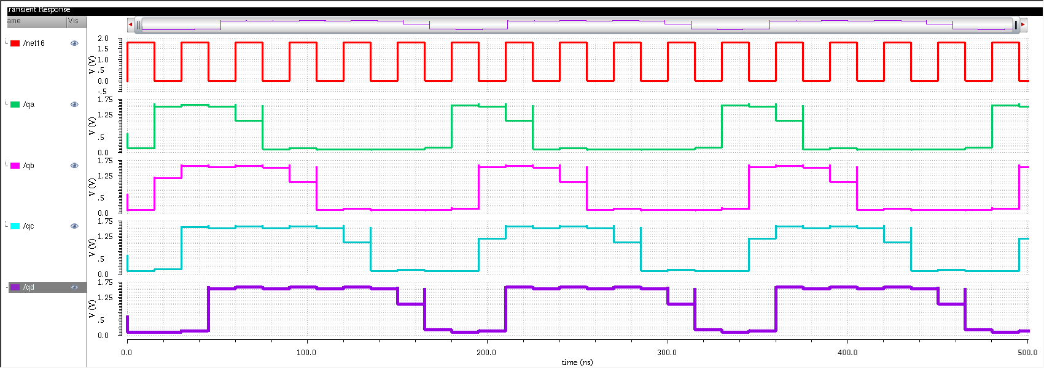
22nm CMOS Johnson Counter
Net 16 : clock (red)
Output :
Qa (green)
Qb (pink)
Qc (blue)
Qd(purple)

Slide 47
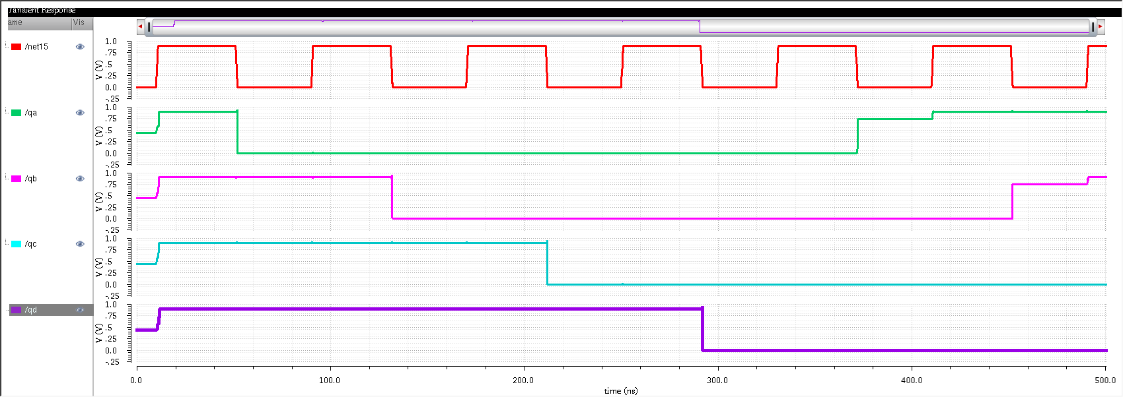
22nm FinFET Johnson Counter
Net 16 : clock (red)
Output :
Qa (green)
Qb (pink)
Qc (blue)
Qd(purple)

Slide 48
Results of Johnson Counter
Parameter | FinFET | CMOS
Delay (S) | 751.7 p | 45.13 n
Power (avg) | 38.90 uw | 40.04 mw
Figure of merit | 0.29 f J/conversion rate | 1.8 f J/conversion rate

Slide 49
Results of 3-Bit Flash ADC
Parameter | FinFET | CMOS
Delay (S) | 17.21n | 367.7 n
Power (avg) | 5.569 mw | 12.82 mw
Figure of merit | 0.095 f J/conversion rate | 4.7 f J/conversion rate

Slide 50
Application
ADC is generally used in high frequency applications such as radar detection, wideband radio receivers, microwave and optical communications etc. Among several ADC converters Flash ADC is proposed due to its speed, accuracy and its simple logic for binary conversion.
Flash ADC applications:
Satellite Communication
RADAR processing
Oscilloscope

Slide 51
Application
The applications of Johnson counter are :
Johnson counters are used as frequency dividers and pattern recognizers.
It is used as a synchronous decade counter and divider circuit
It can be used to create complicated finite state machines in hardware logic design.
The frequency of the clock signal is divided by varying their feedback.

Slide 52
Work Flow
Sep-Oct: Paper survey, topic search, finalization, approval from guide.
Nov: Start of the project work with literature survey.
Dec: Tool download and practice of Cadence Tool.
Jan: Design of basic circuits for Flash ADC.
Feb: Design of basic circuit for Johnson Ring Counter.
Mar: Design of cells for all the circuits we created.
Apr: FinFET Combining all the 4 DFF to develop Johnson Ring Counter.
May: Combining all the basic cells to develop Flash ADC.
June: Evaluating both combinational and sequential logic circuits in FinFET and Final submission.

Slide 53
References
Mr. Tilak Kumar L, Chandan A, Chethan kumar K M, Dommeti Venkata Sai Krishna Vasanth, Hemant, “Power Efficient 4 Bit Flash ADC Using Cadence Tool”, International Research Journal of Engineering and Technology (IRJET), Volume: 09,(Issue: 07 e-ISSN: 2395-0056) p-ISSN: 2395-0072, 2022
Nirali Hemant Patel “Power Efficient 4-bit Flash ADC using Cadence Virtuoso” International Journal of Engineering Research & Technology (IJERT) ISSN: 2278-0181 Vol. 10 Issue 03, 2019
Vedura Appala Raju, B.V. R. Gowri “Johnson Counter Using Master Slave D Flip Flop” International Journal of Management, Technology And Engineering Volume 8, Issue XII, DECEMBER/2018 ISSN NO : 2249-7455, Volume 8, Issue XII
M Reddi Sekhar, P Uma, D Venkataramana Pushpalatha D Viswanada reddy “An efficient priority encoder & decoder using 45nm FinFET technology” JETIR March 2019, Volume 6, Issue 3
Vasudeva G, Uma B V 22nm FINFET Based High Gain Wide Band Differential Amplifier “International journal of circuits, systems and signal processing” DOI: 10.46300/9106.2021.15.7 Volume 15, 2021.

Slide 54




